Slide 1
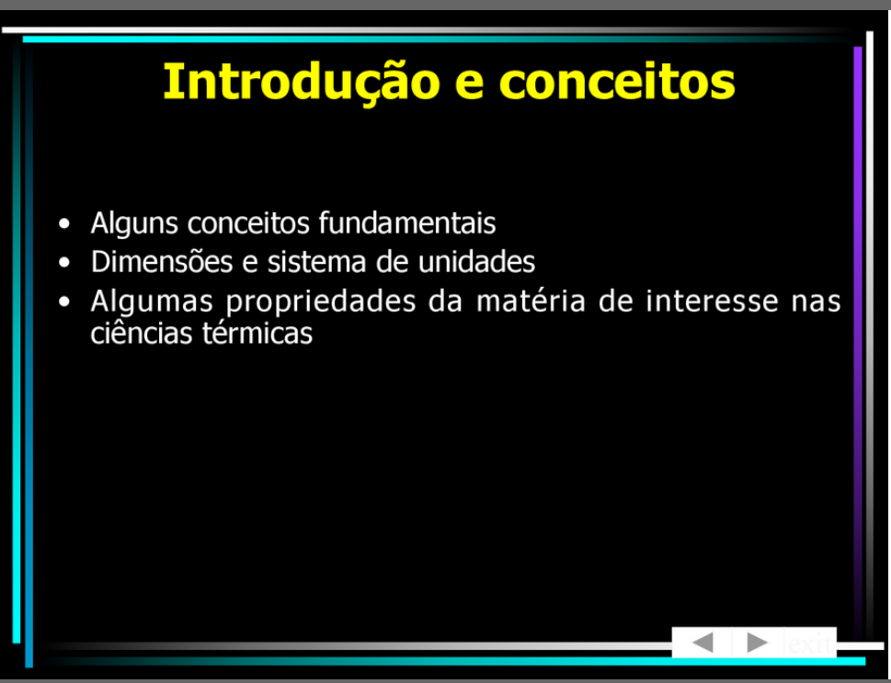
Slide 1 — 1/53

Slide 2
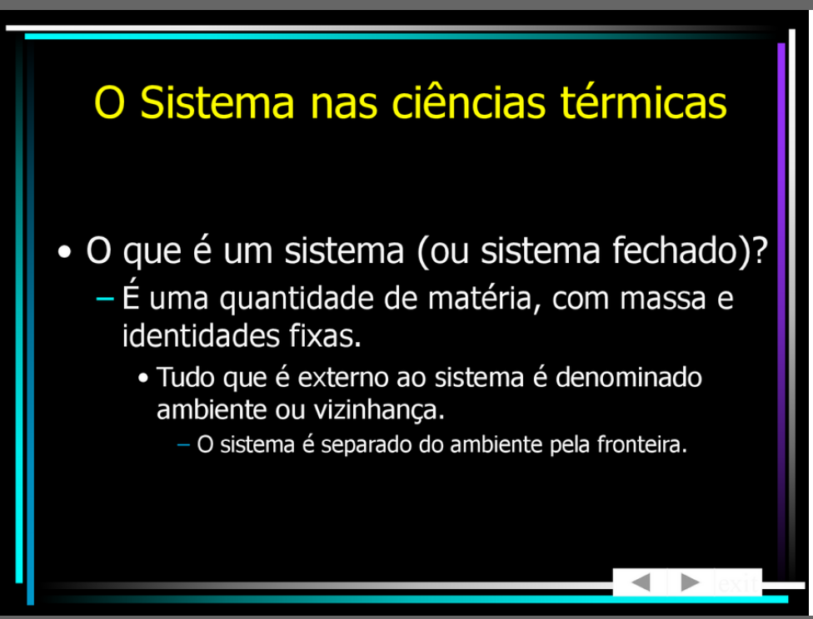
Slide 1 — 2/53

Slide 3
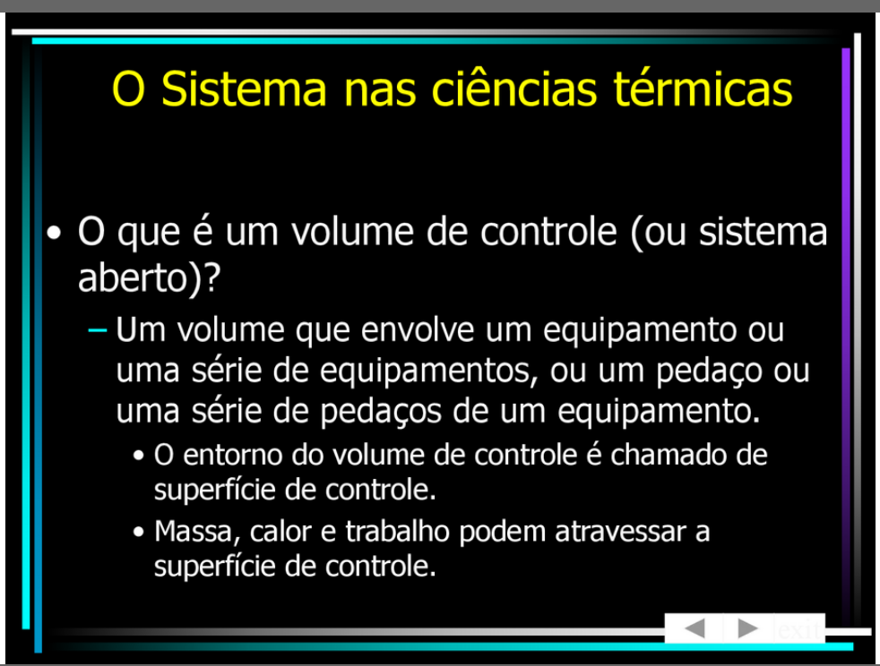
Slide 1 — 3/53

Slide 4
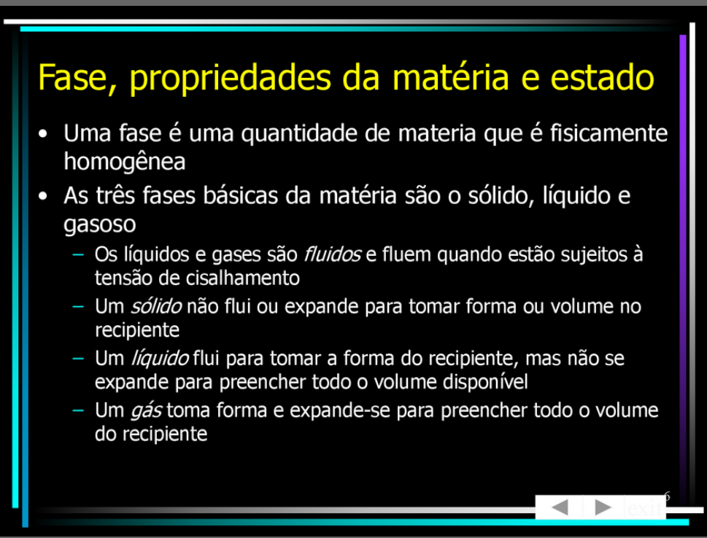
Slide 1 — 4/53

Slide 5
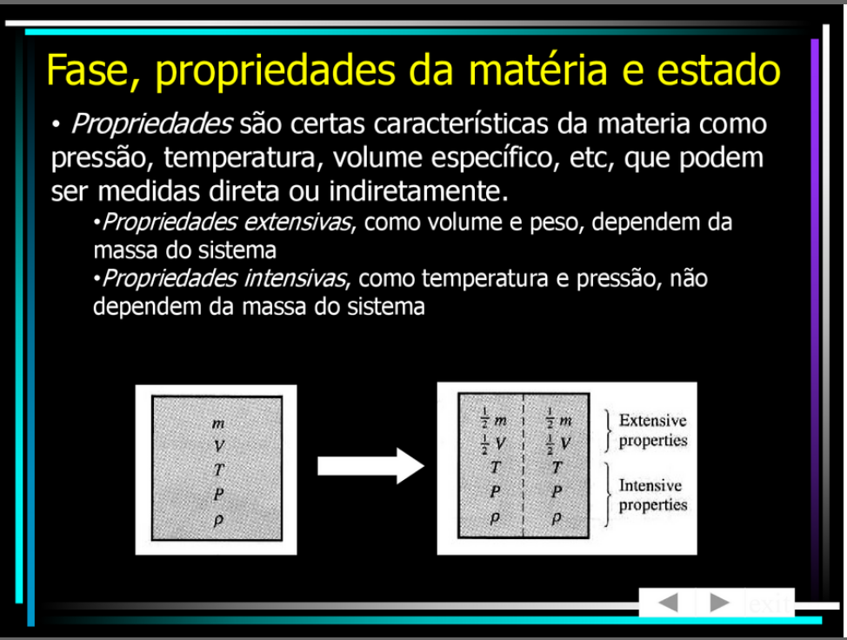
Slide 1 — 5/53

Slide 6
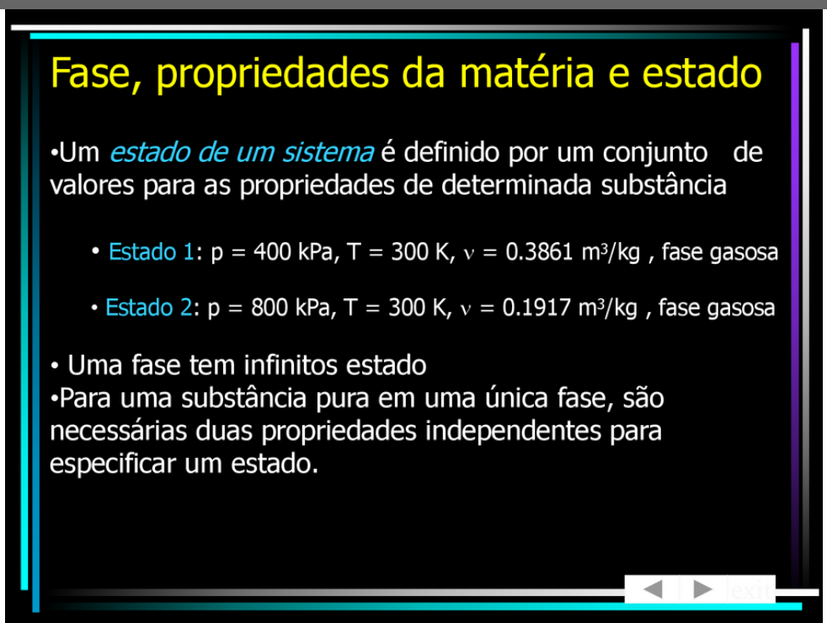
Slide 1 — 6/53

Slide 7
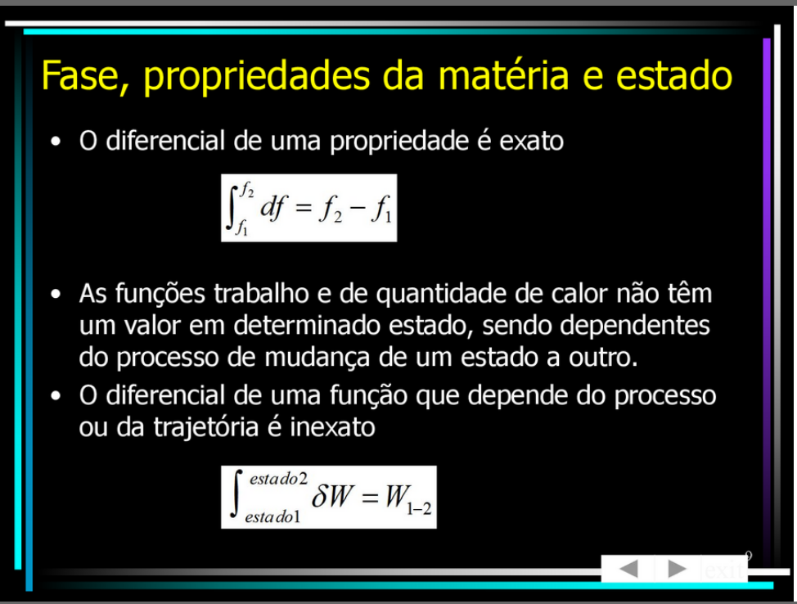
Slide 1 — 7/53

Slide 8
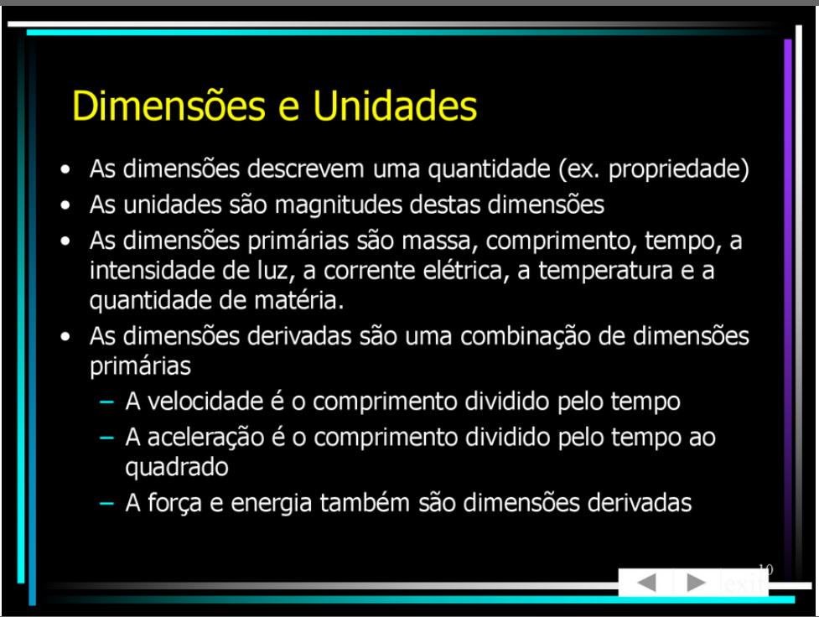
Slide 1 — 8/53

Slide 9
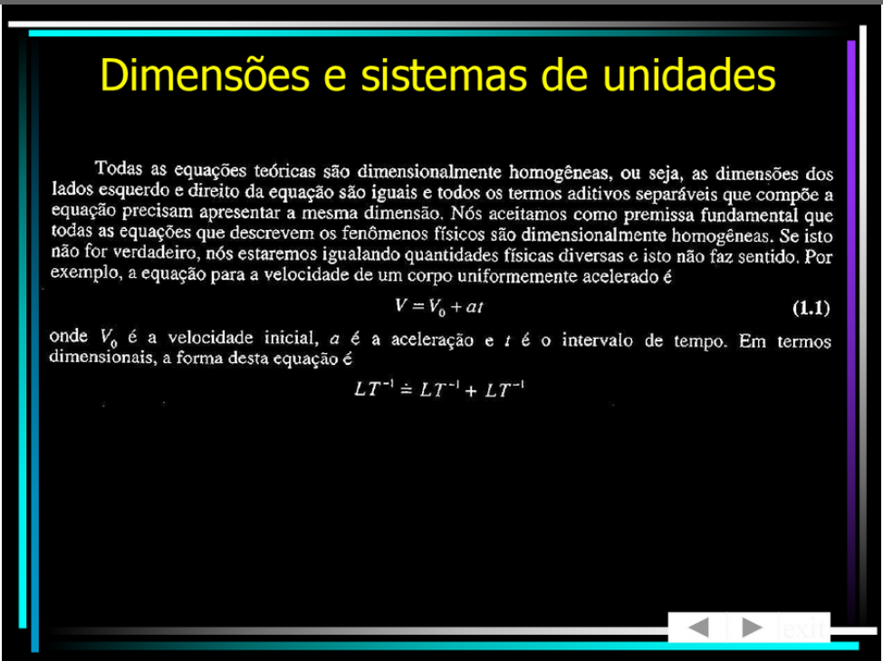
Slide 1 — 9/53

Slide 10
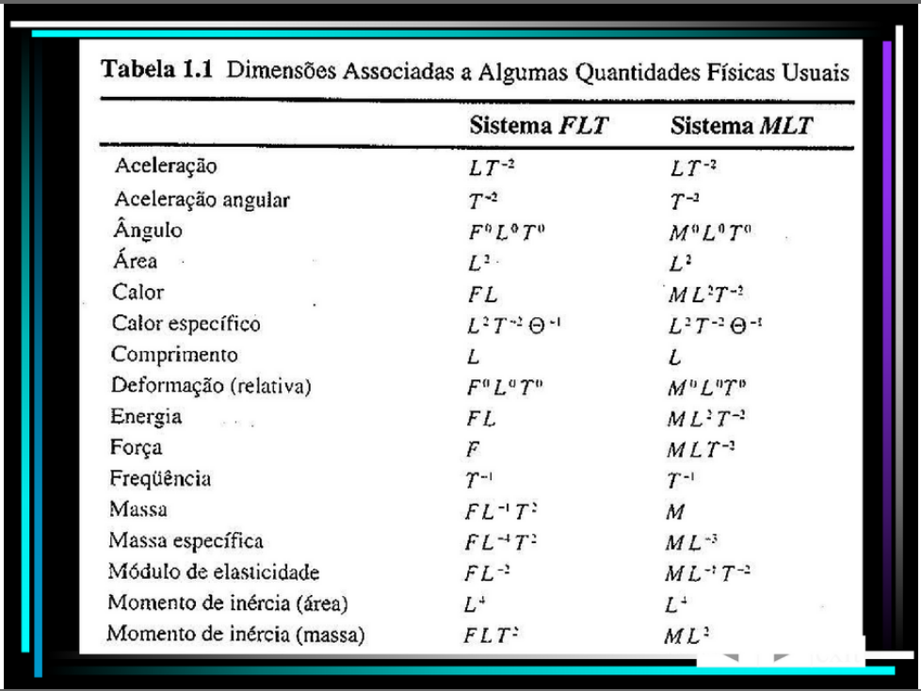
Slide 1 — 10/53

Slide 11
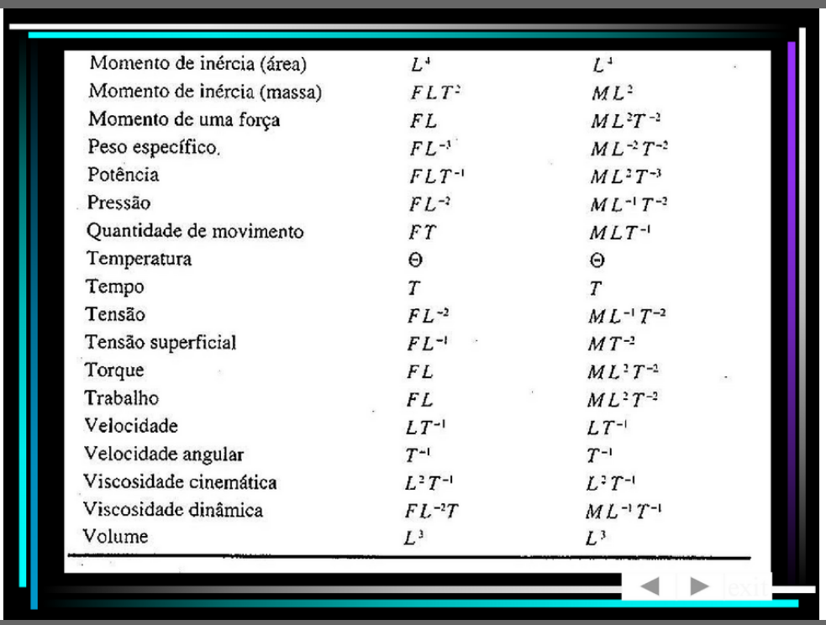
Slide 1 — 11/53

Slide 12
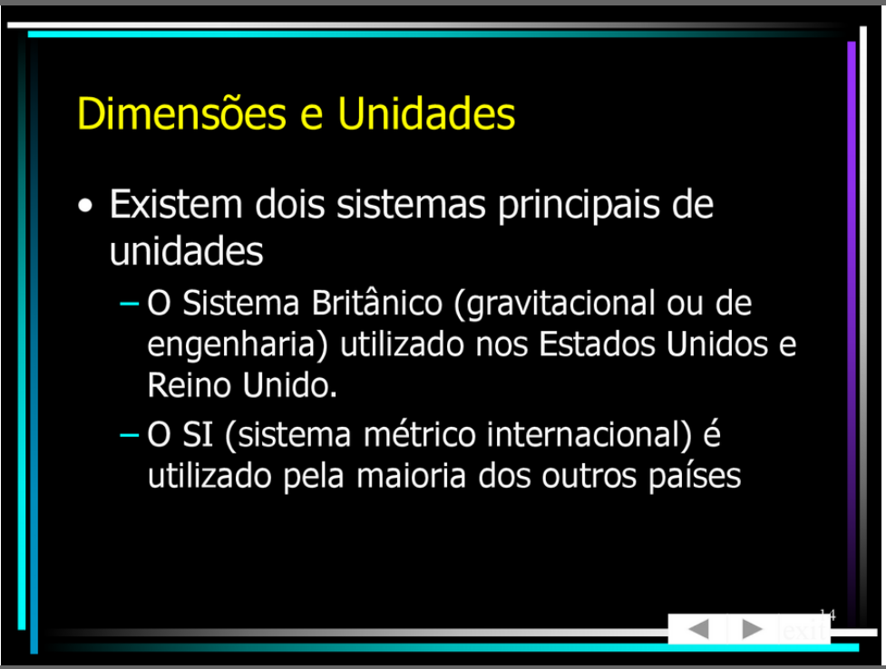
Slide 1 — 12/53

Slide 13
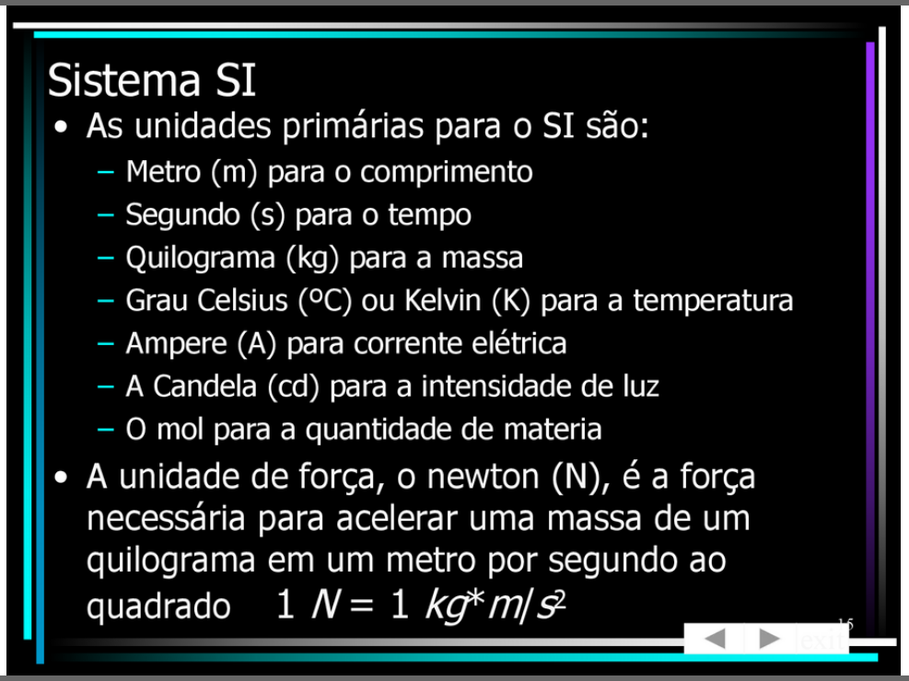
Slide 1 — 13/53

Slide 14
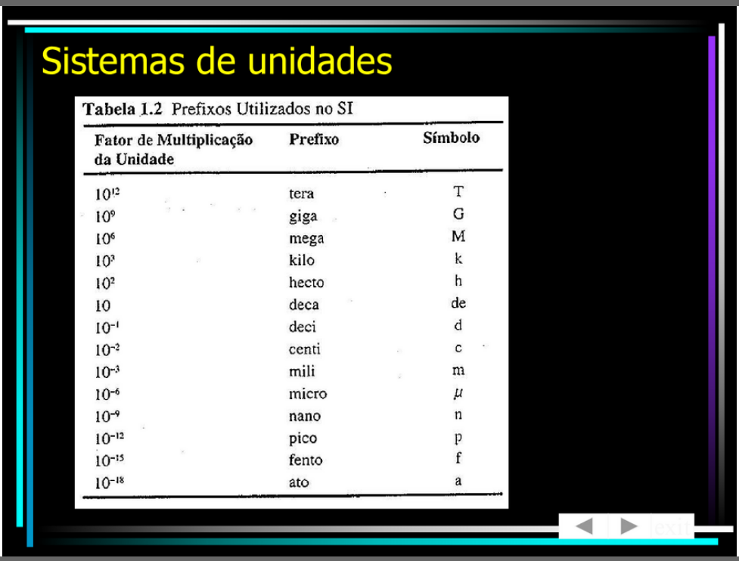
Slide 1 — 14/53

Slide 15
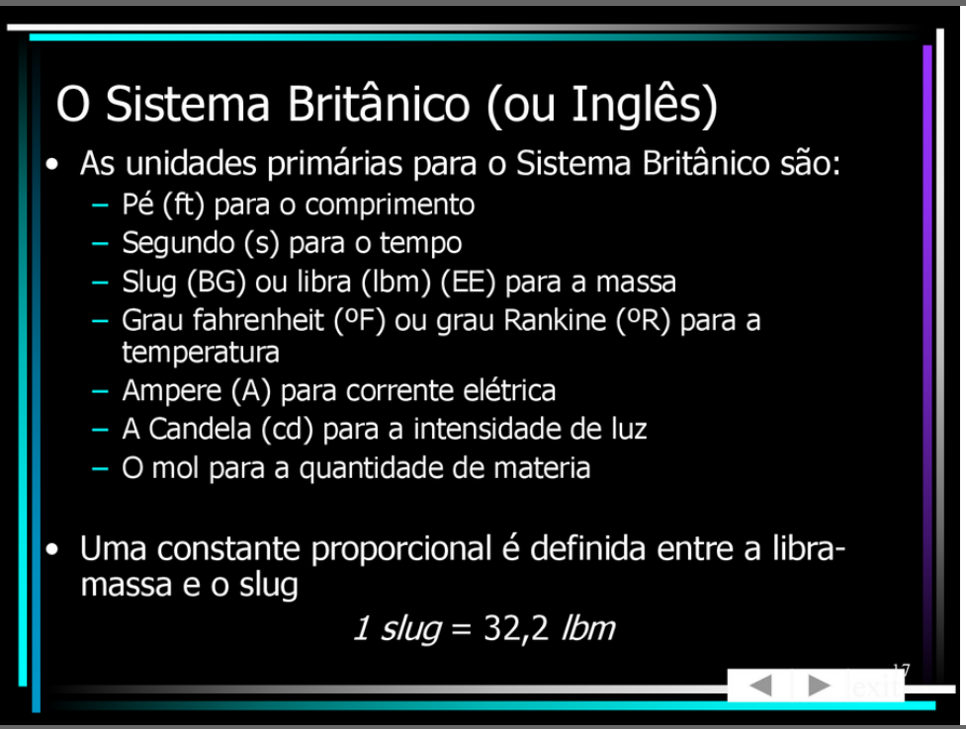
Slide 1 — 15/53

Slide 16

Slide 1 — 16/53

Slide 17
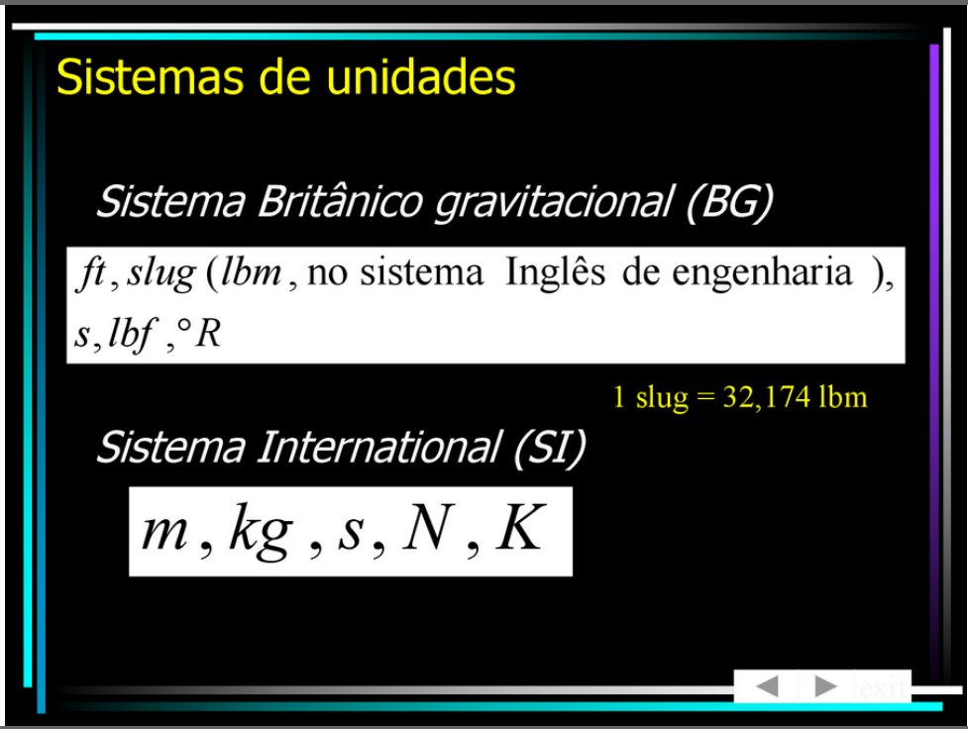
Slide 1 — 17/53

Slide 18
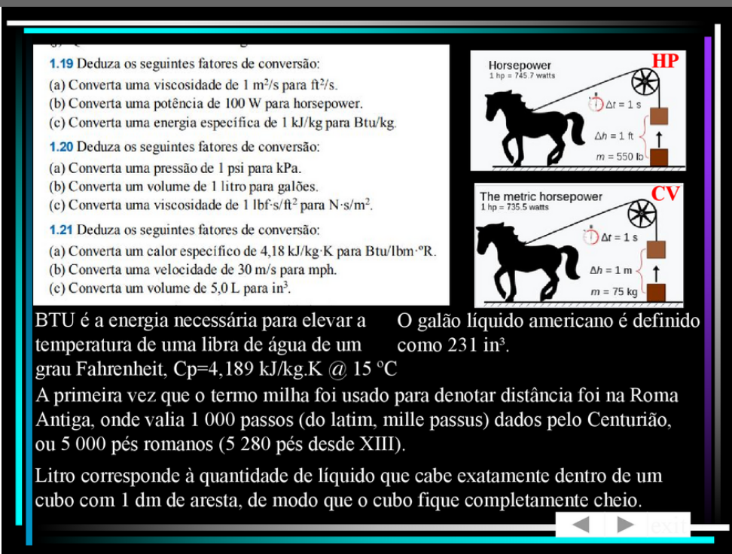
Slide 1 — 18/53

Slide 19
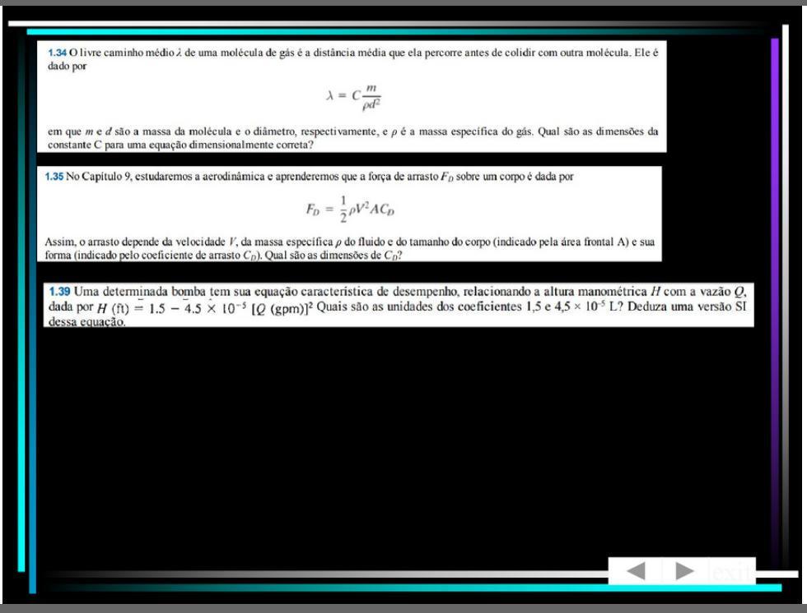
Slide 1 — 19/53

Slide 20
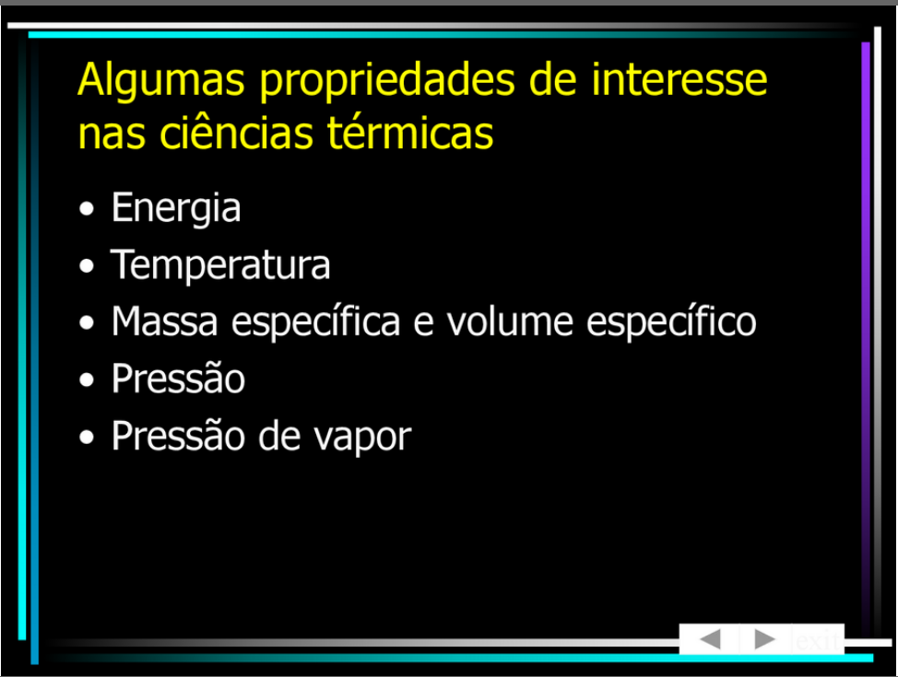
Slide 1 — 20/53

Slide 21
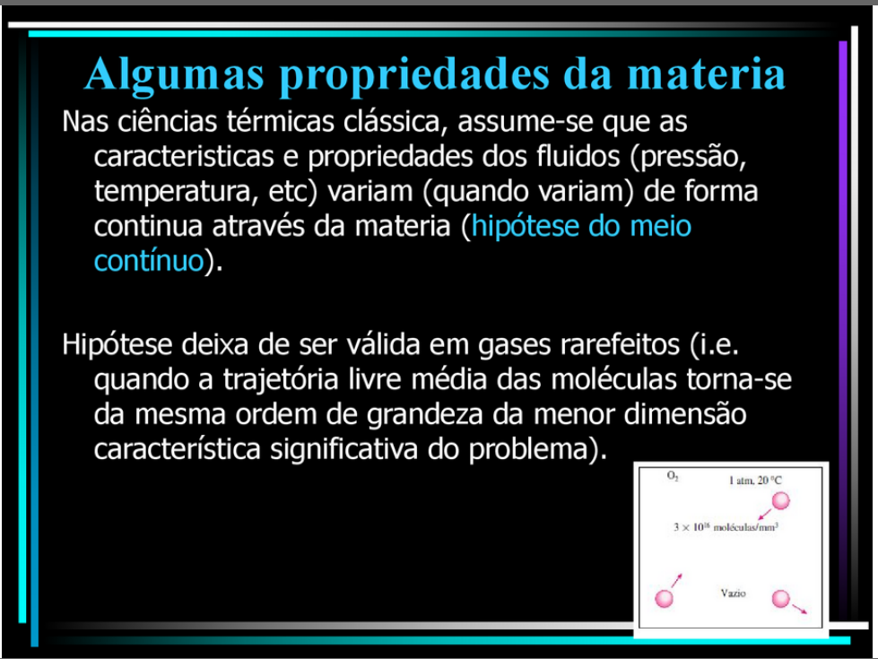
Slide 1 — 21/53

Slide 22
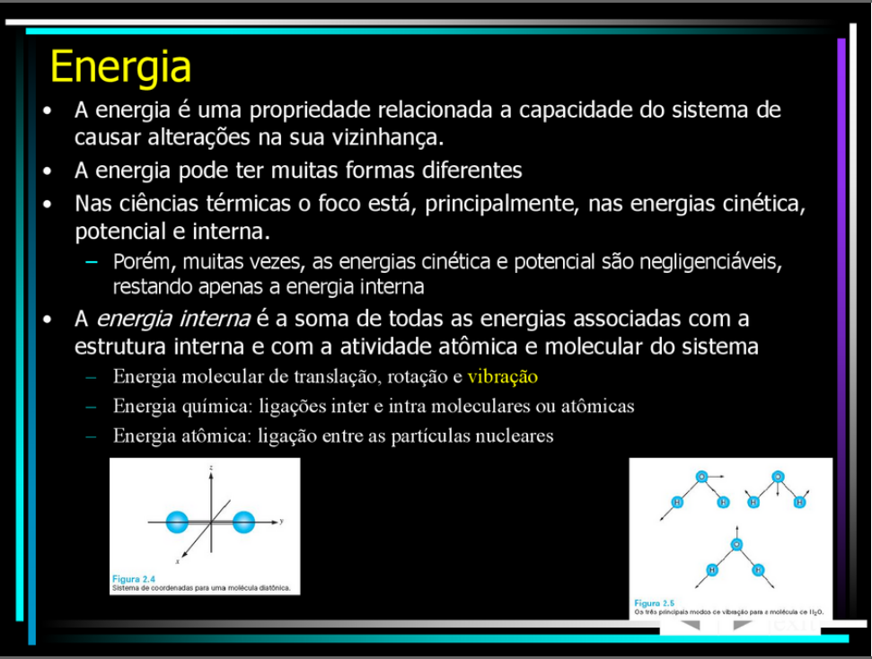
Slide 1 — 22/53

Slide 23
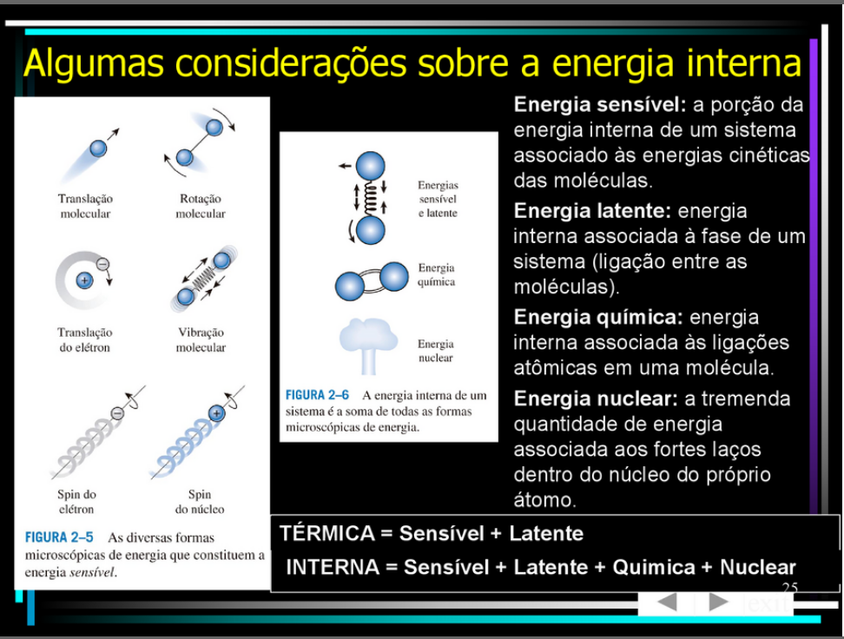
Slide 1 — 23/53

Slide 24
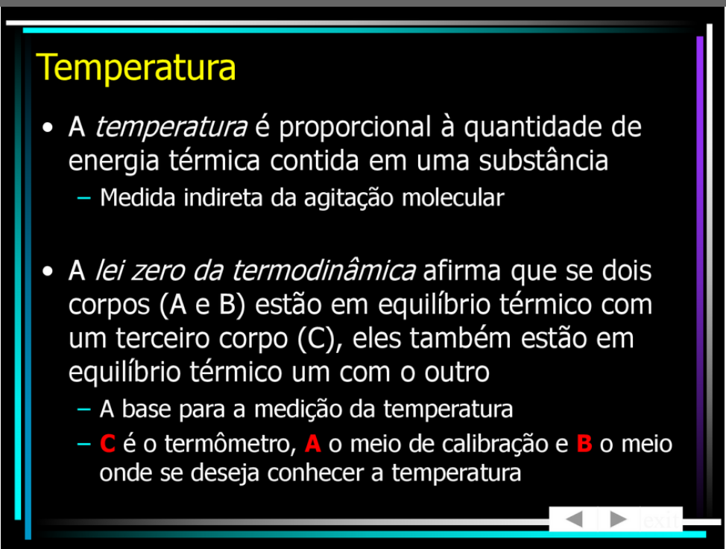
Slide 1 — 24/53

Slide 25
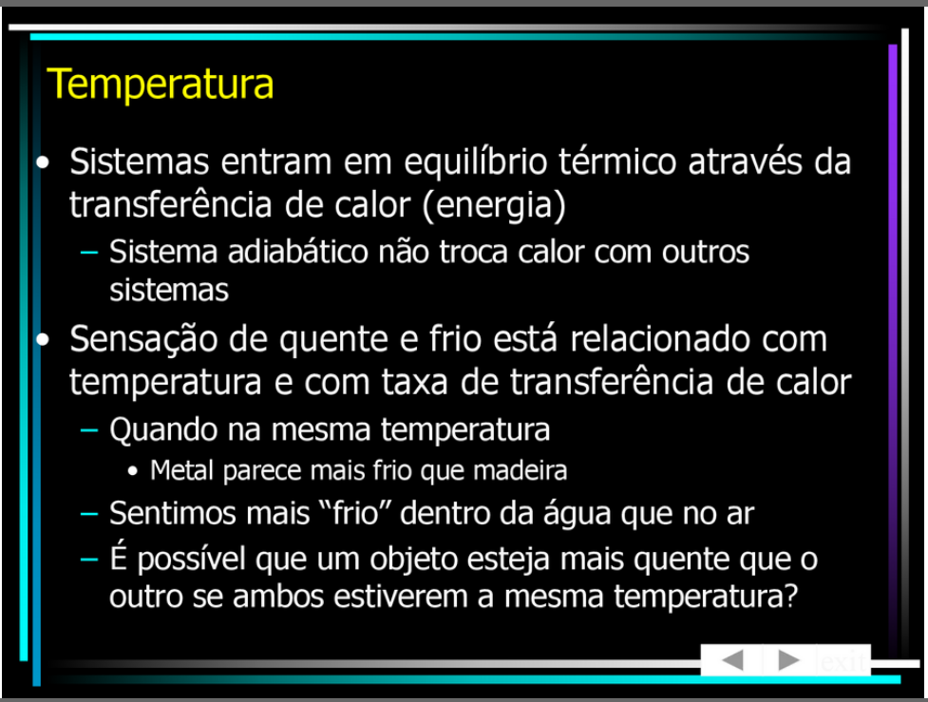
Slide 1 — 25/53

Slide 26
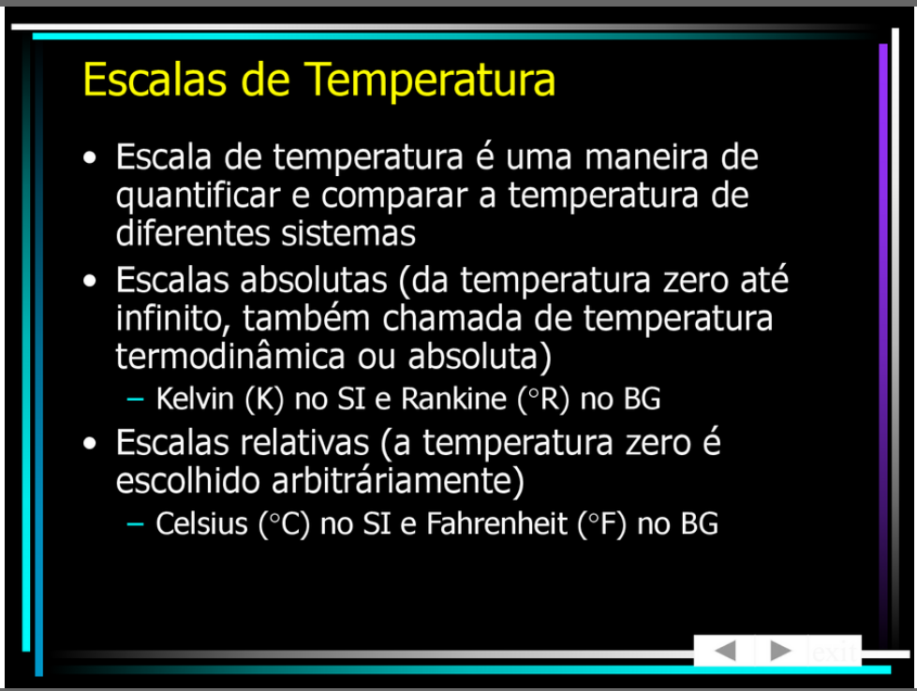
Slide 1 — 26/53

Slide 27
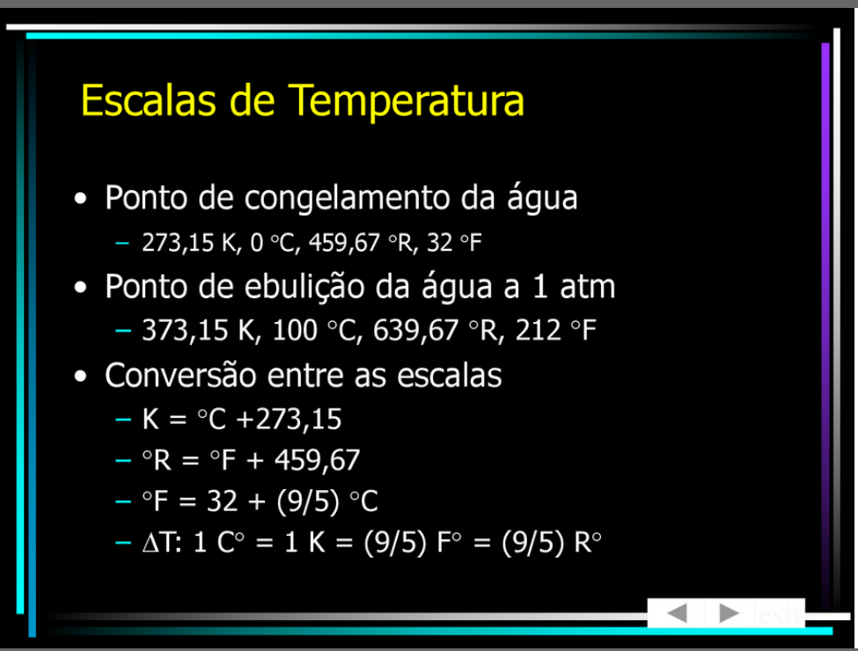
Slide 1 — 27/53

Slide 28
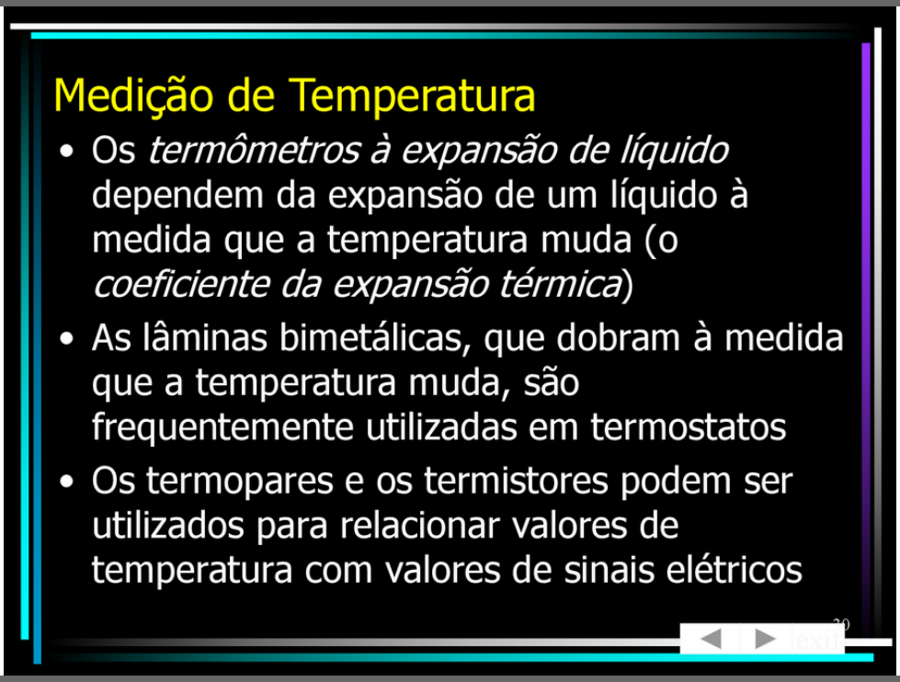
Slide 1 — 28/53

Slide 29
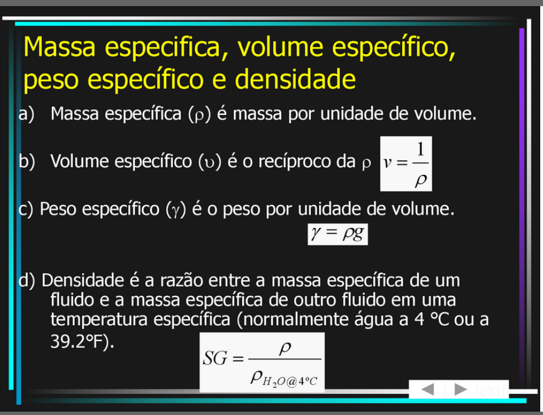
Slide 1 — 29/53

Slide 30
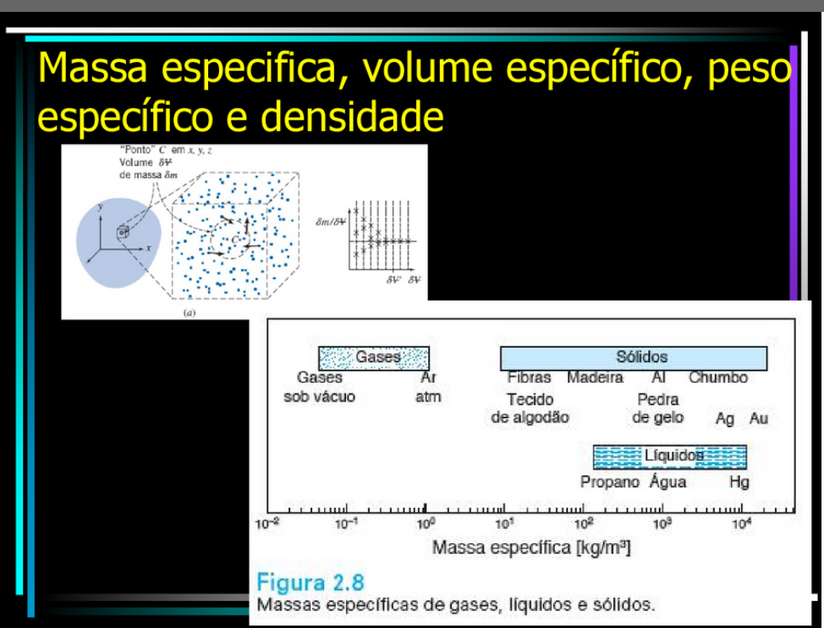
Slide 1 — 30/53

Slide 31
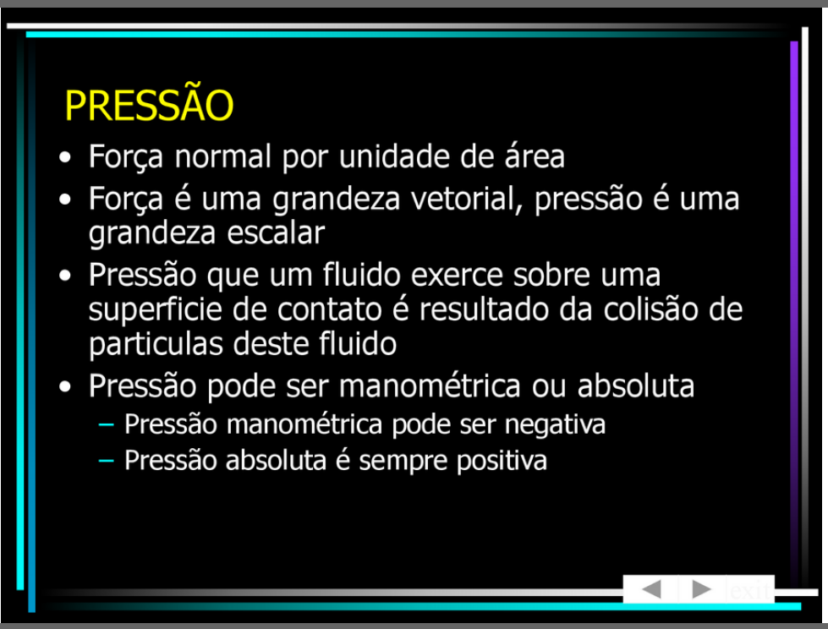
Slide 1 — 31/53

Slide 32
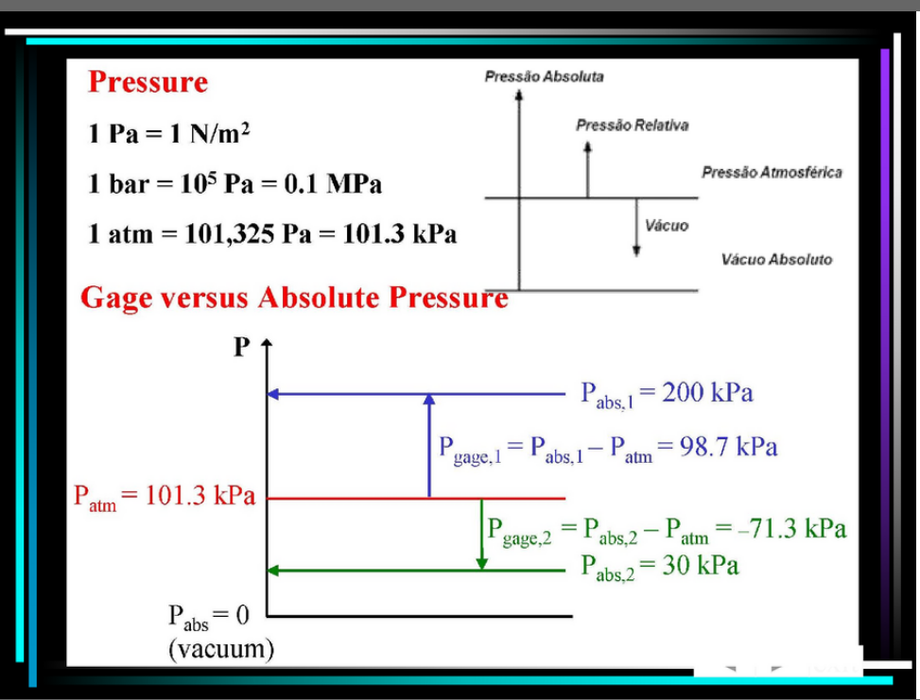
Slide 1 — 32/53

Slide 33
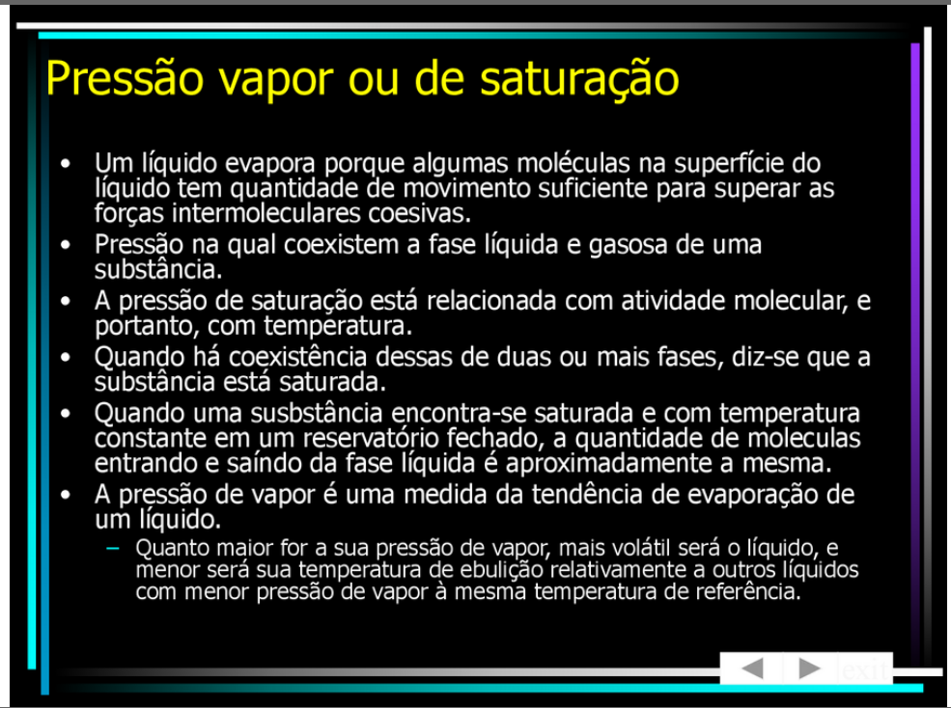
Slide 1 — 33/53

Slide 34
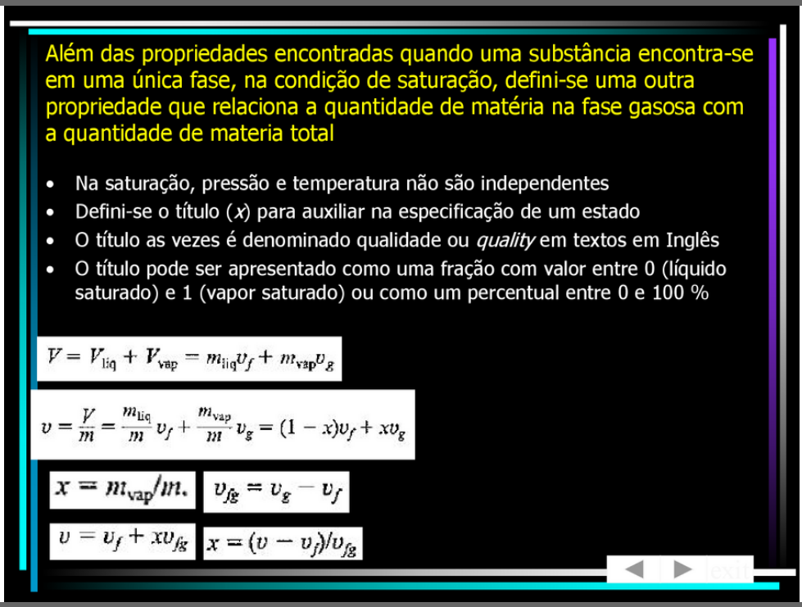
Slide 1 — 34/53

Slide 35
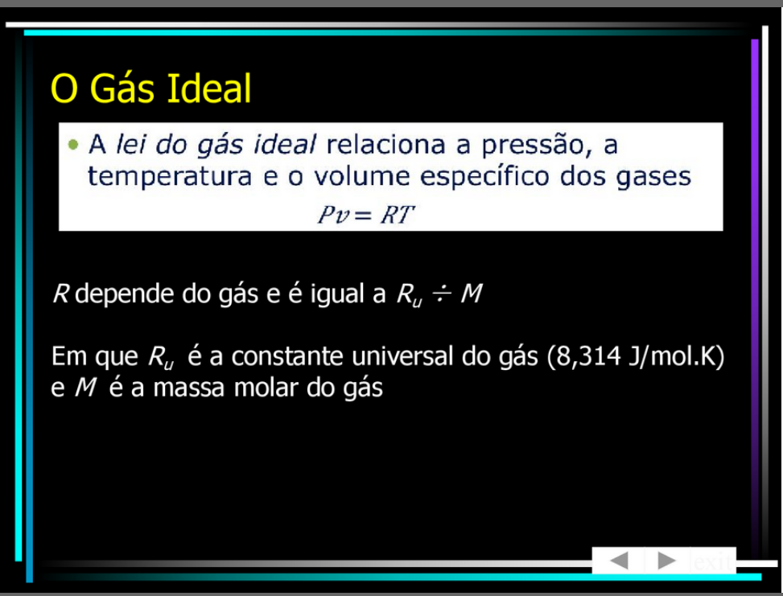
Slide 1 — 35/53

Slide 36
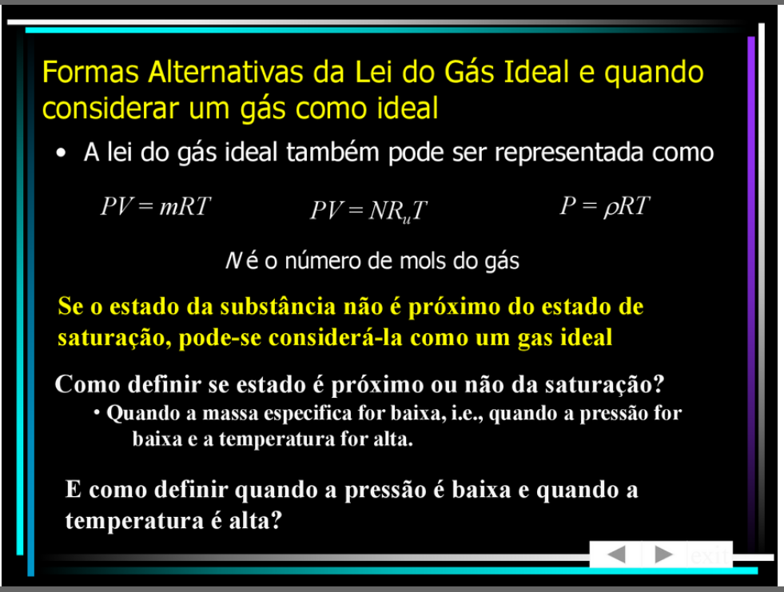
Slide 1 — 36/53

Slide 37
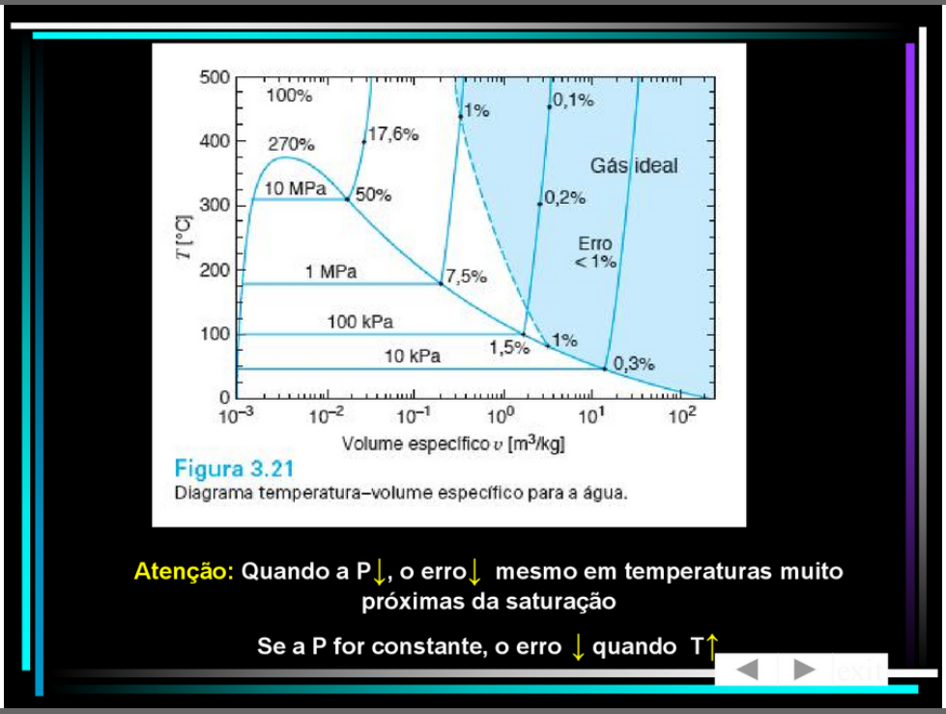
Slide 1 — 37/53

Slide 38
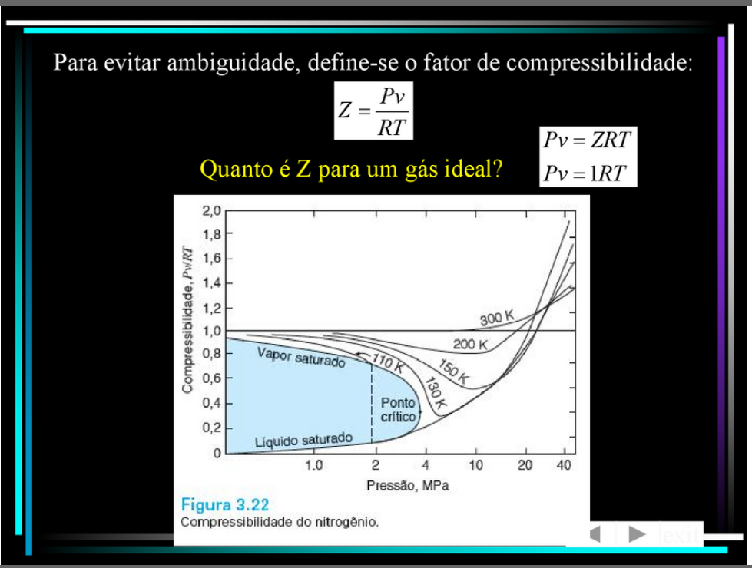
Slide 1 — 38/53

Slide 39
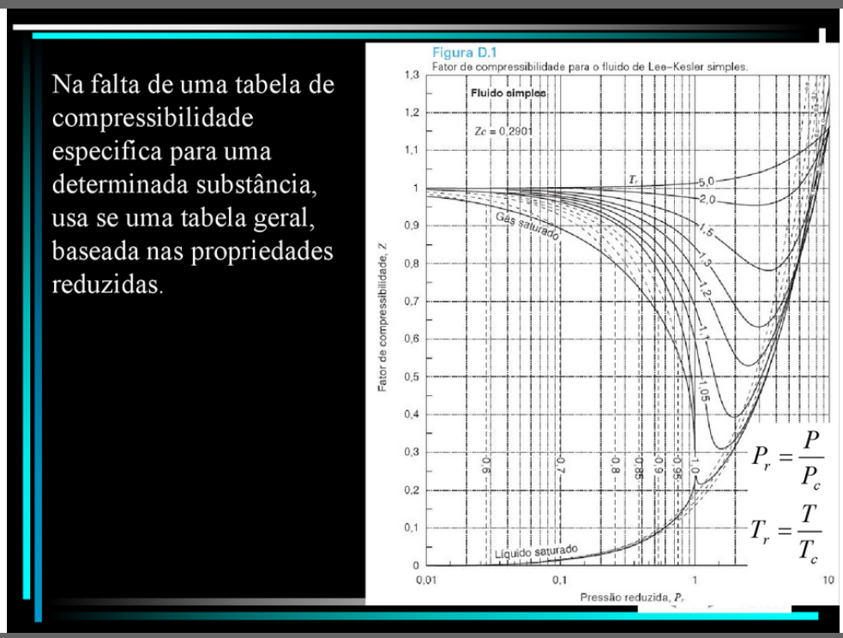
Slide 1 — 39/53

Slide 40
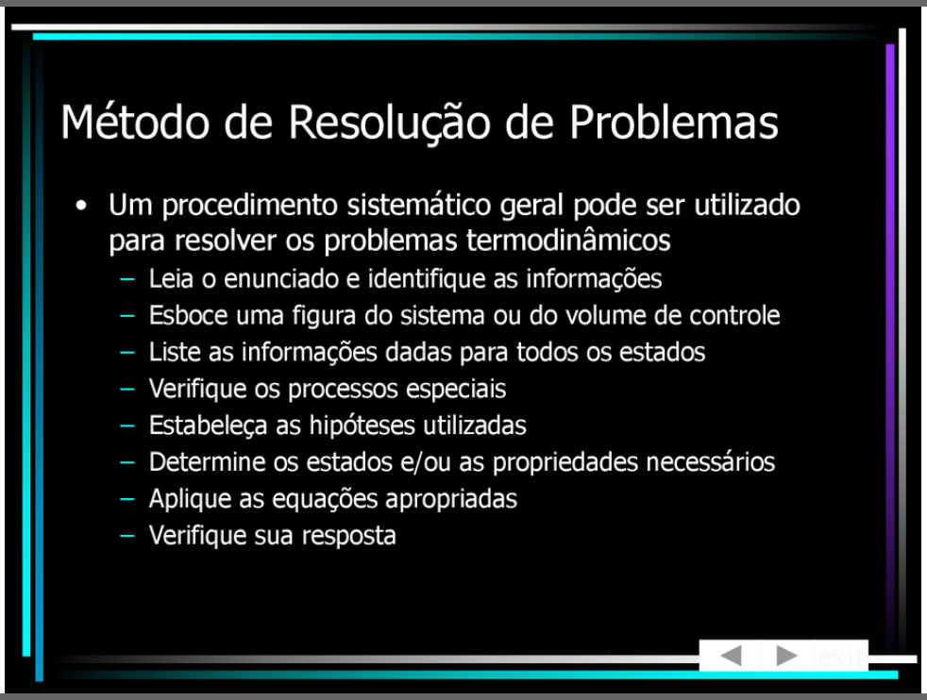
Slide 1 — 40/53

Slide 41
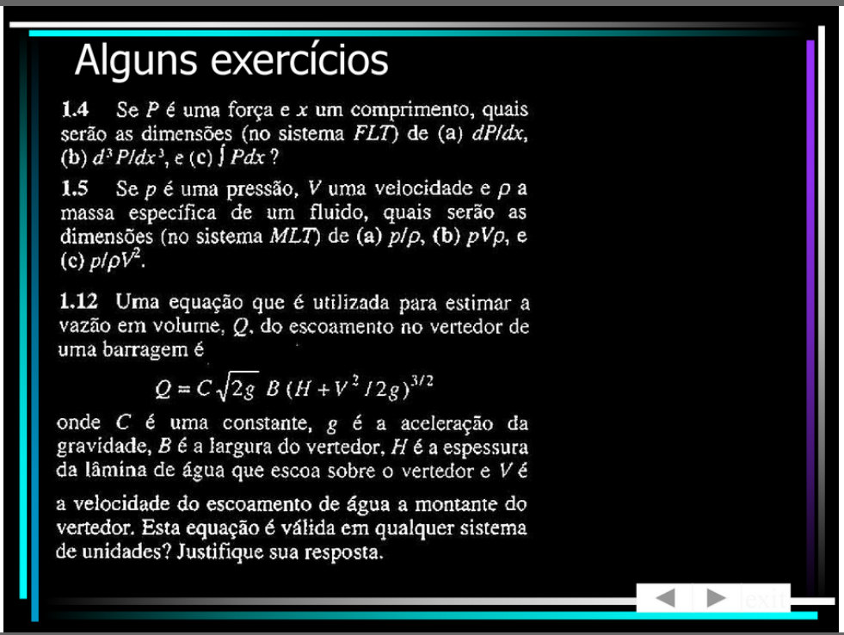
Slide 1 — 41/53

Slide 42
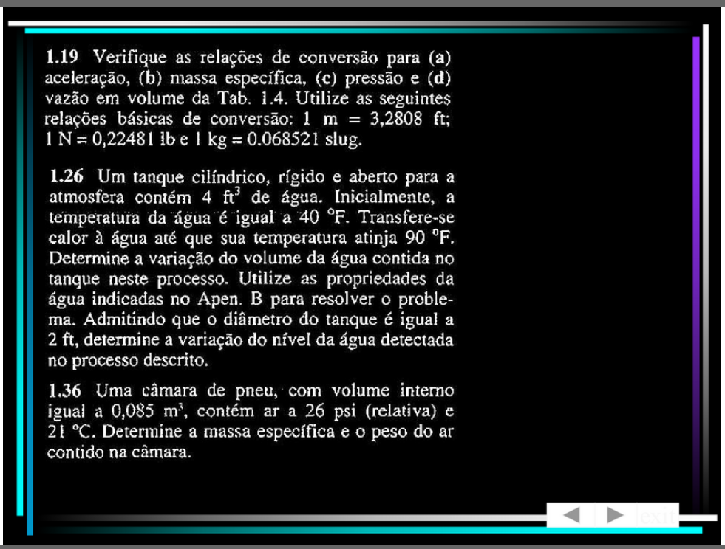
Slide 1 — 42/53

Slide 43
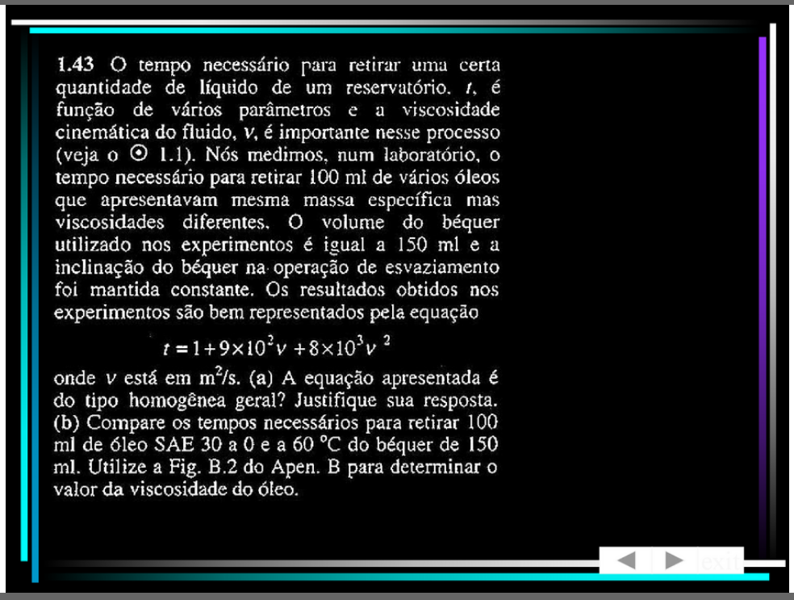
Slide 1 — 43/53

Slide 44
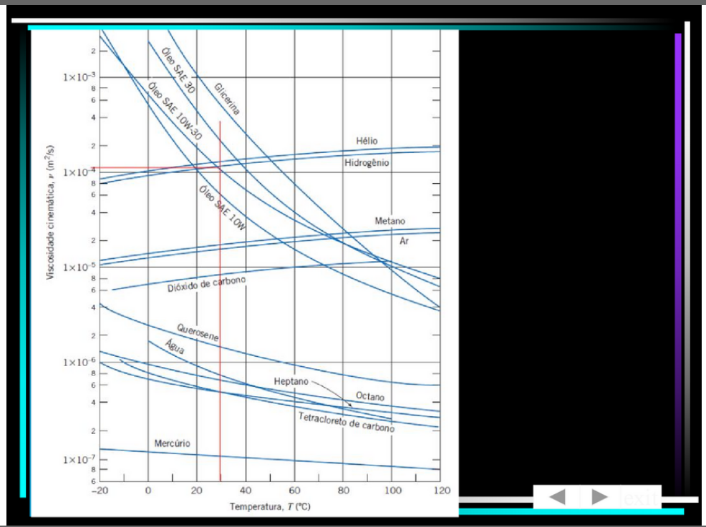
Slide 1 — 44/53

Slide 45
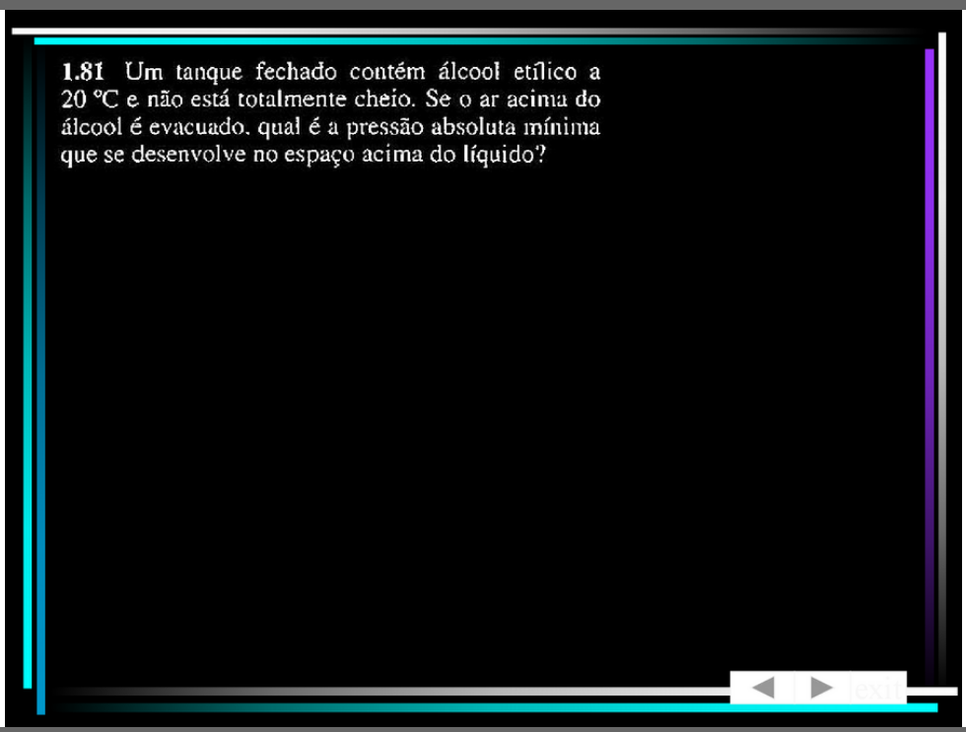
Slide 1 — 45/53

Slide 46
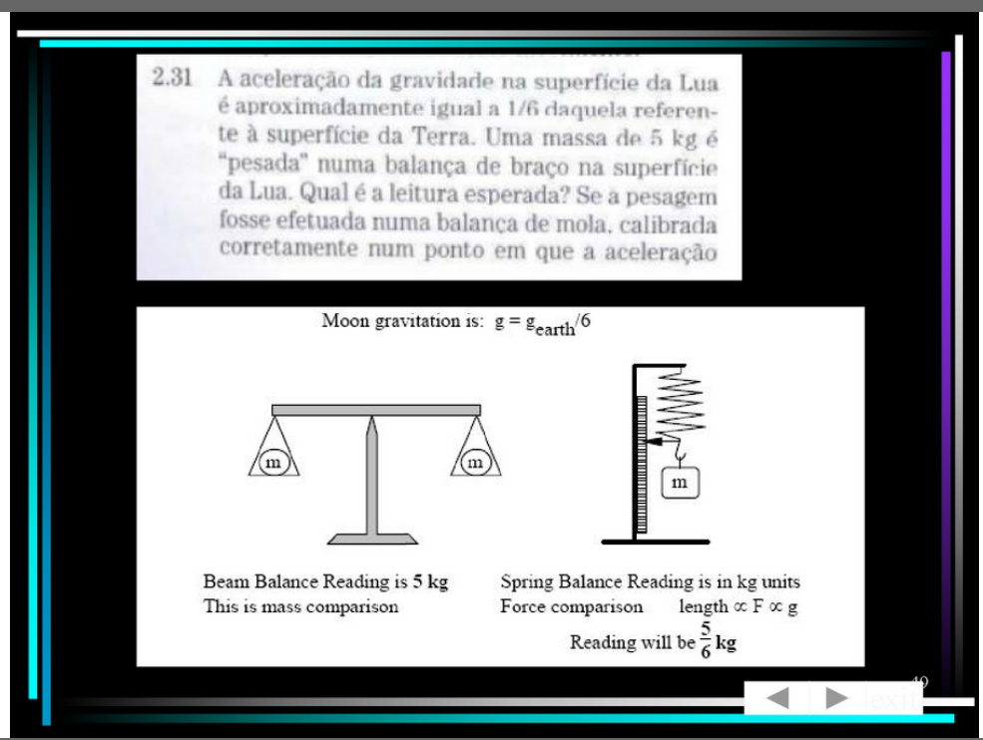
Slide 1 — 46/53

Slide 47
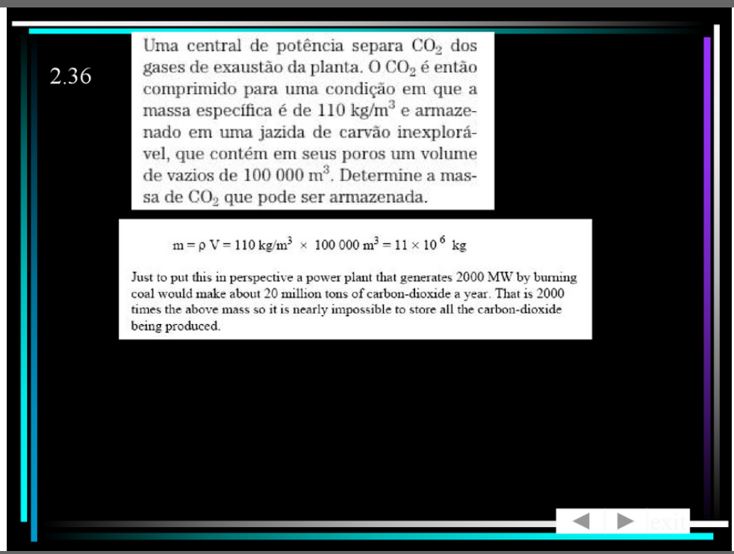
Slide 1 — 47/53

Slide 48
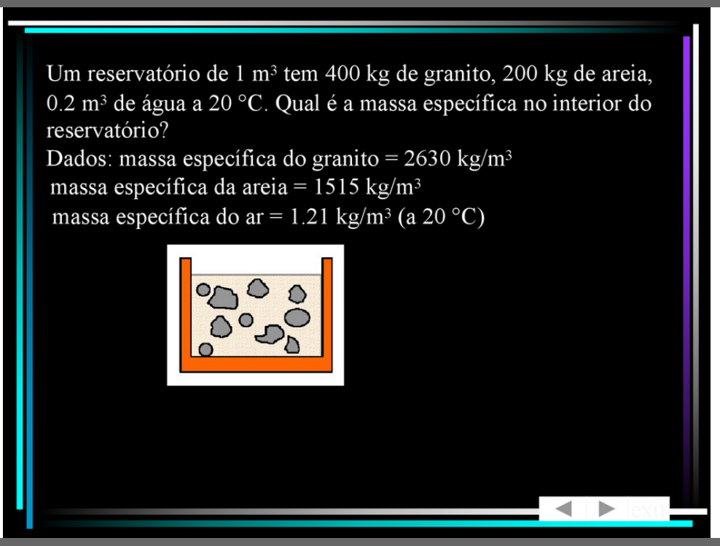
Slide 1 — 48/53

Slide 49
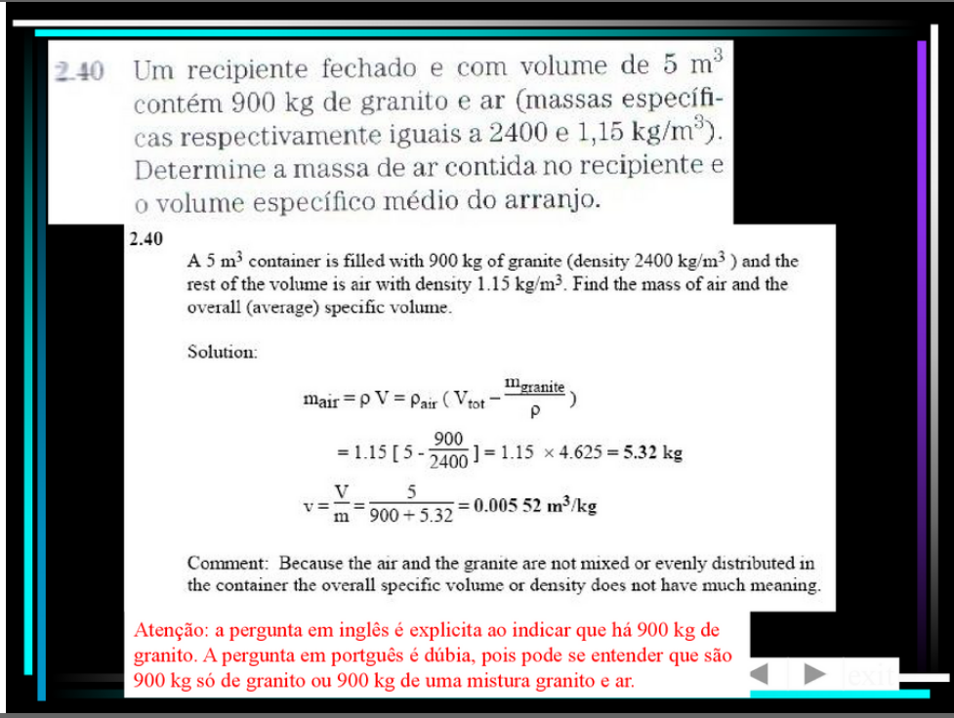
Slide 1 — 49/53

Slide 50
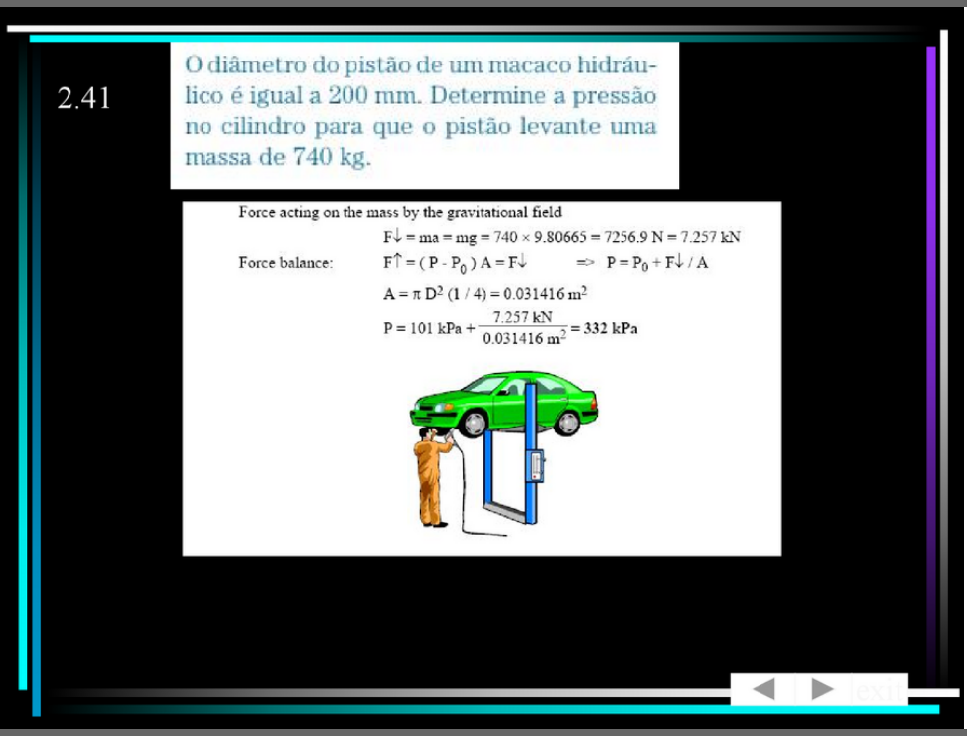
Slide 1 — 50/53

Slide 51
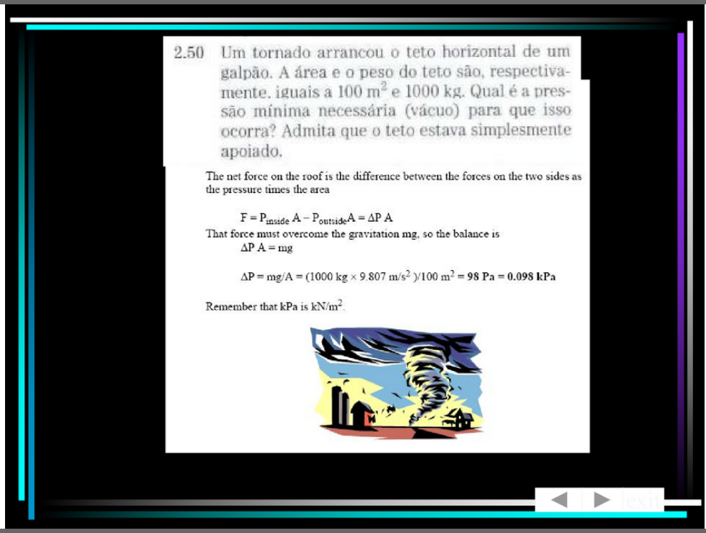
Slide 1 — 51/53

Slide 52

Slide 1 — 52/53

Slide 53

Slide 1 — 53/53

